Slide 1
Problem Statement
To develop an advanced movie recommendation system that :
Predicts the user’s preferences based on the ratings and user feedback
Predict the most suitable movies in line with the viewers who have similar interests.

Slide 2
Objectives
To develop an advanced movie recommender model to provide accurate and relevant movies based on users' preferences and movie watching patterns by similar users.
Reduce the browse time leading to improve user satisfaction and enhance user engagement (there by increased user retention for streaming service).

Slide 3
Exploratory Data Analysis
Movies.csv – 62,423 MovieId along with title and genres
Ratings.csv – 25000095 rows of userId, movieId, rating and timestamp. There are no null values in this dataset.
3376 Movies from movies.csv has no data in ratings.csv. Hence, can never be recommended to users.
Genome_scores – ﻿15,584,448 rows – Relevance score for only 13816 movieId and its tagId.

Slide 4
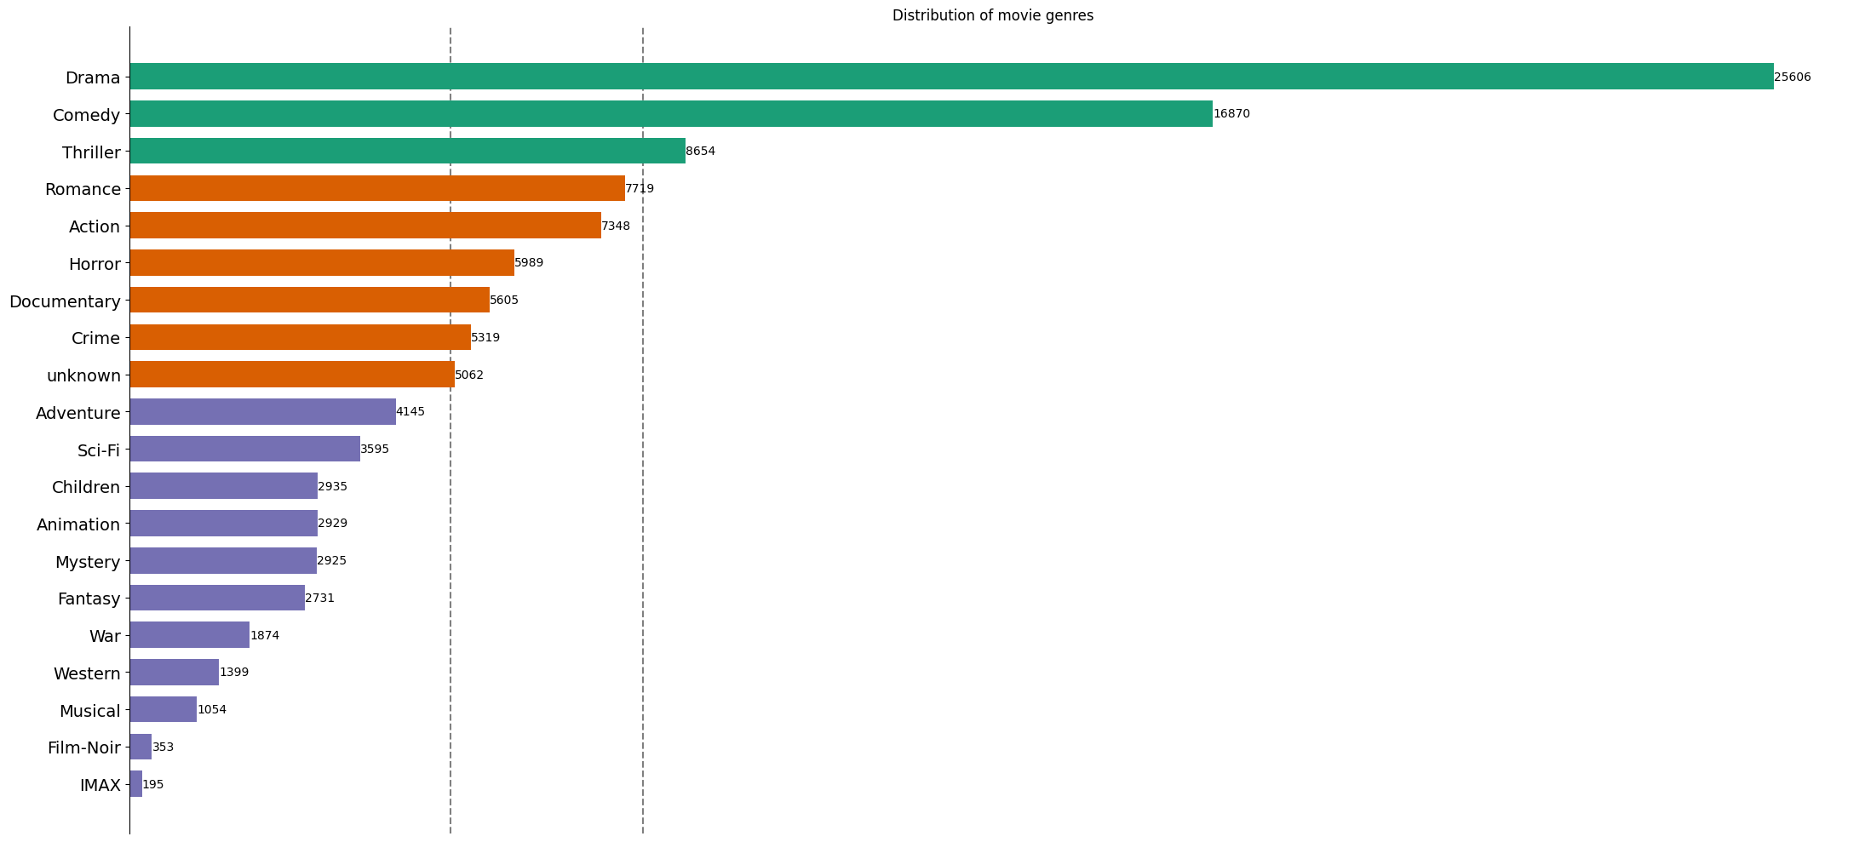

Slide 5
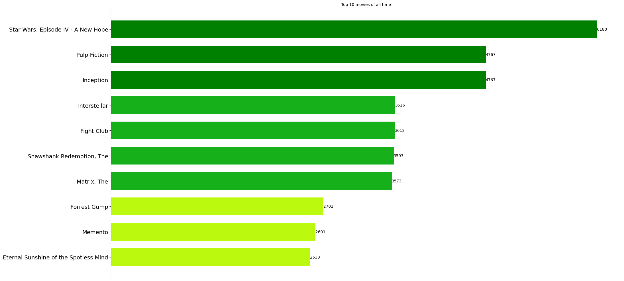

Slide 6
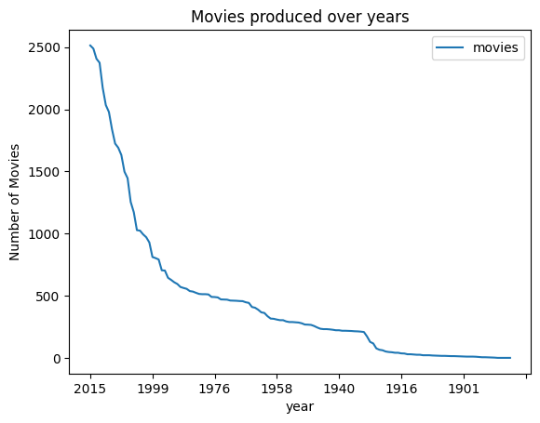

Slide 7
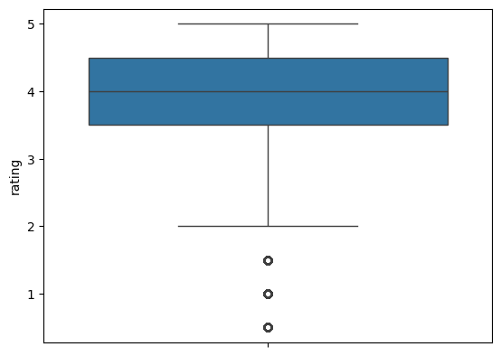
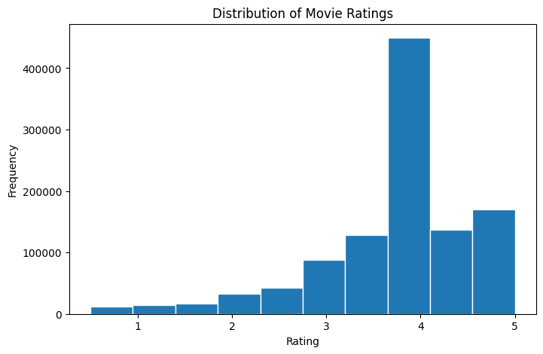

Slide 8

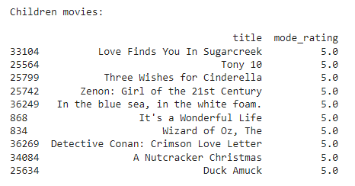
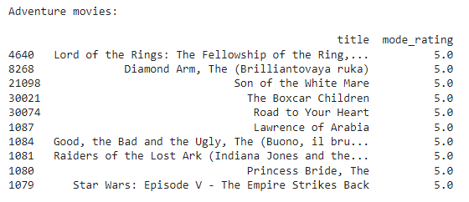
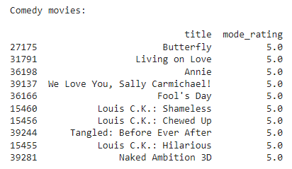
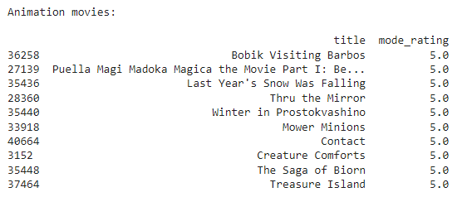

Slide 9
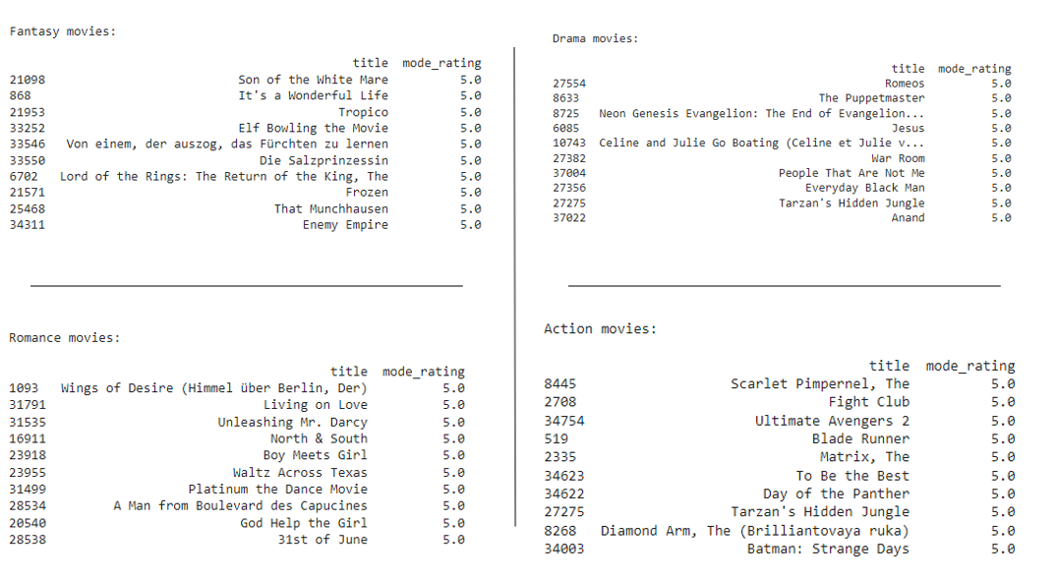

Slide 10
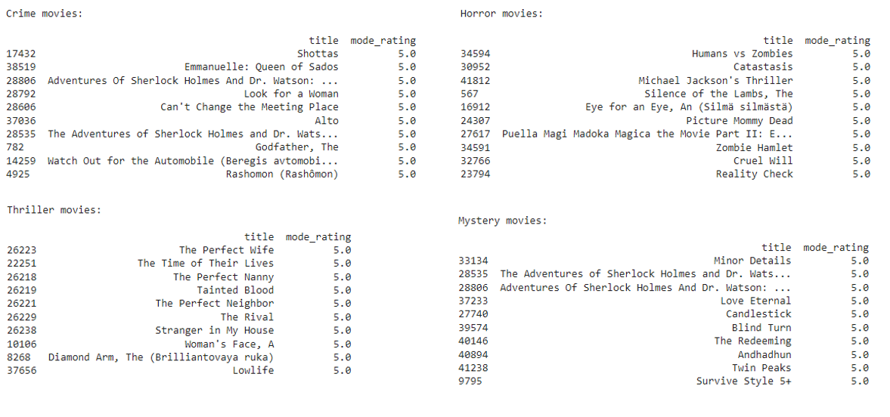

Slide 11
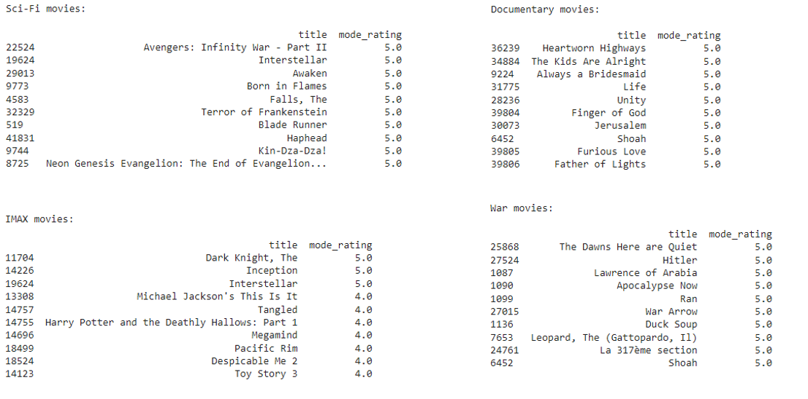

Slide 12
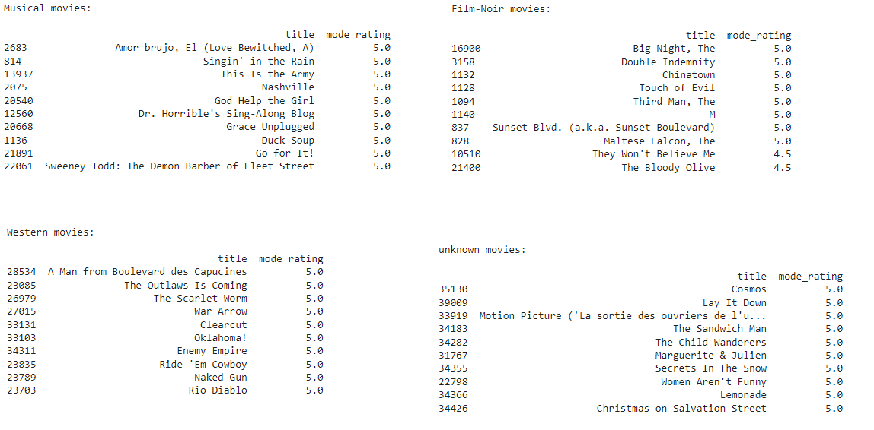

Slide 13
Methodology
Collaborative Filtering
Content – based Filtering
Identify the preferred genres for each user.
Features from User’s rating, relevance score and tags

Slide 14
Design Components
SVD Algorithm – Collaborative Filtering
TF-IDF vectorizer
Features generated – Random Forest
Combine all to recommend the movies for users.

Slide 15
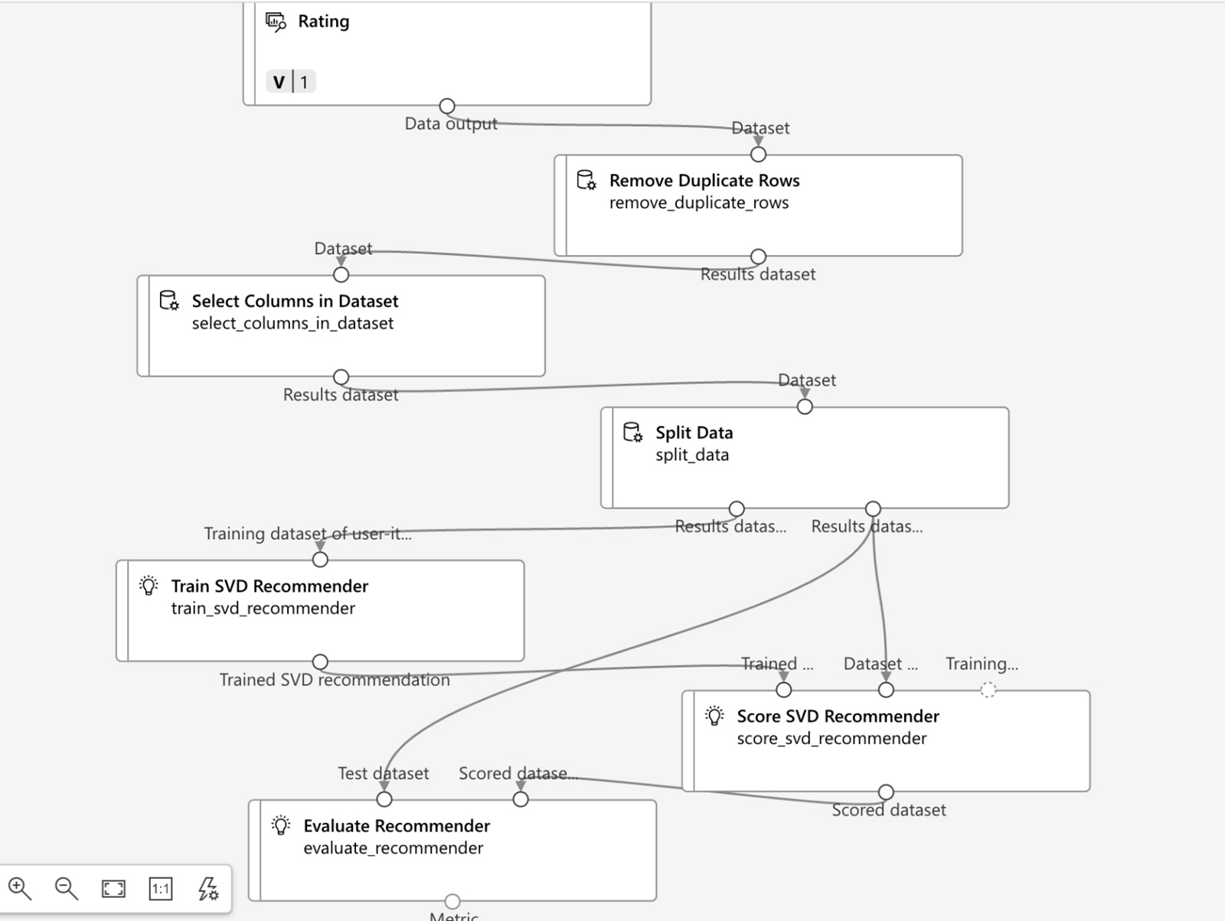
Collaborative Filtering - SVD

Slide 16
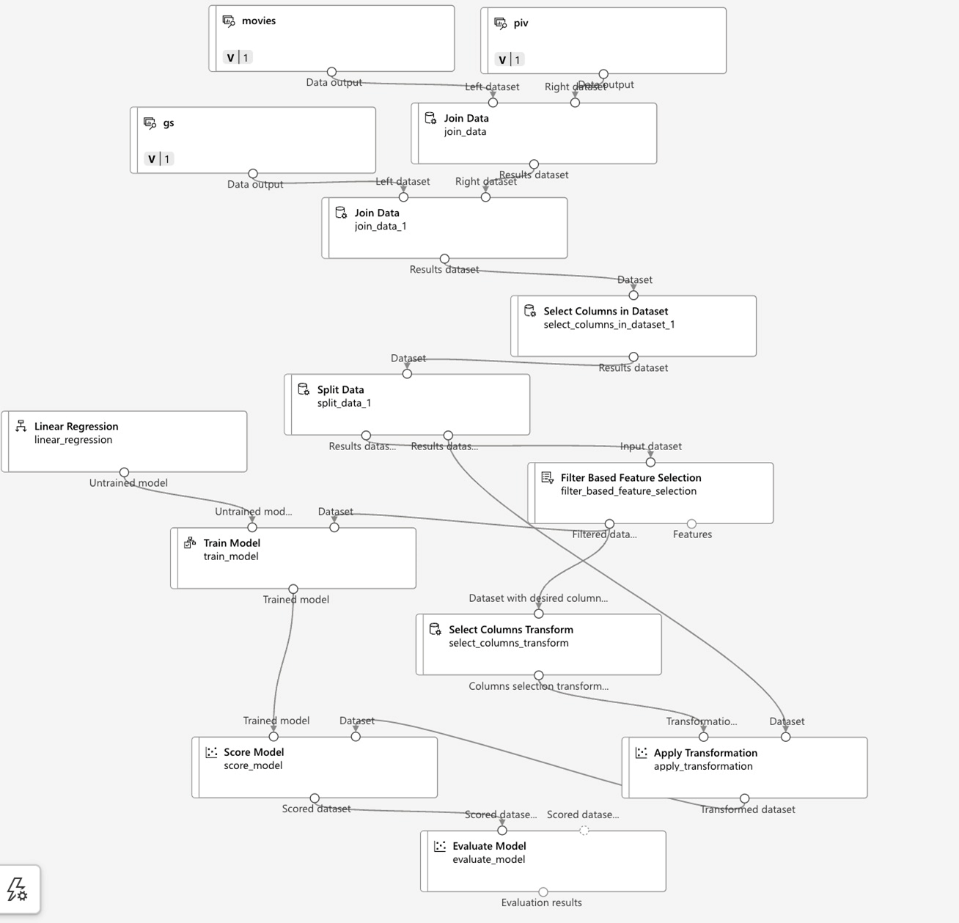
Content based Filtering - TF-IDF

Slide 17
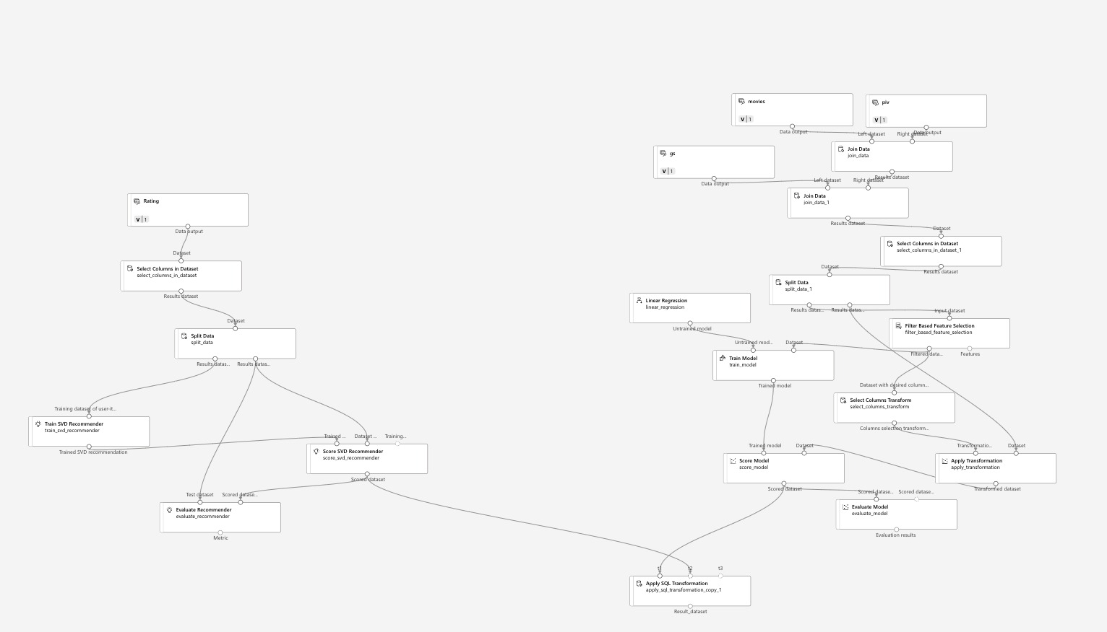
Overall Flow : SVD + TF-IDF

Slide 18
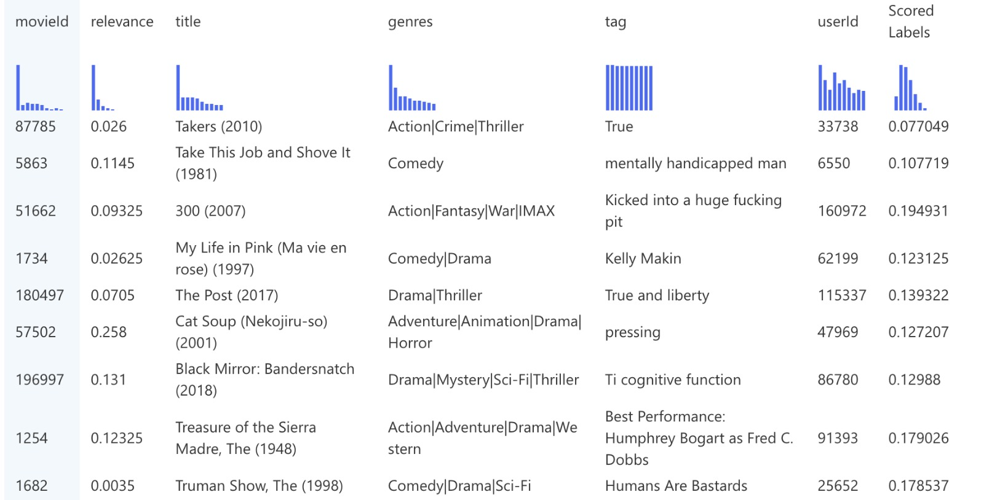
SVD + TF-IDF output

Slide 19
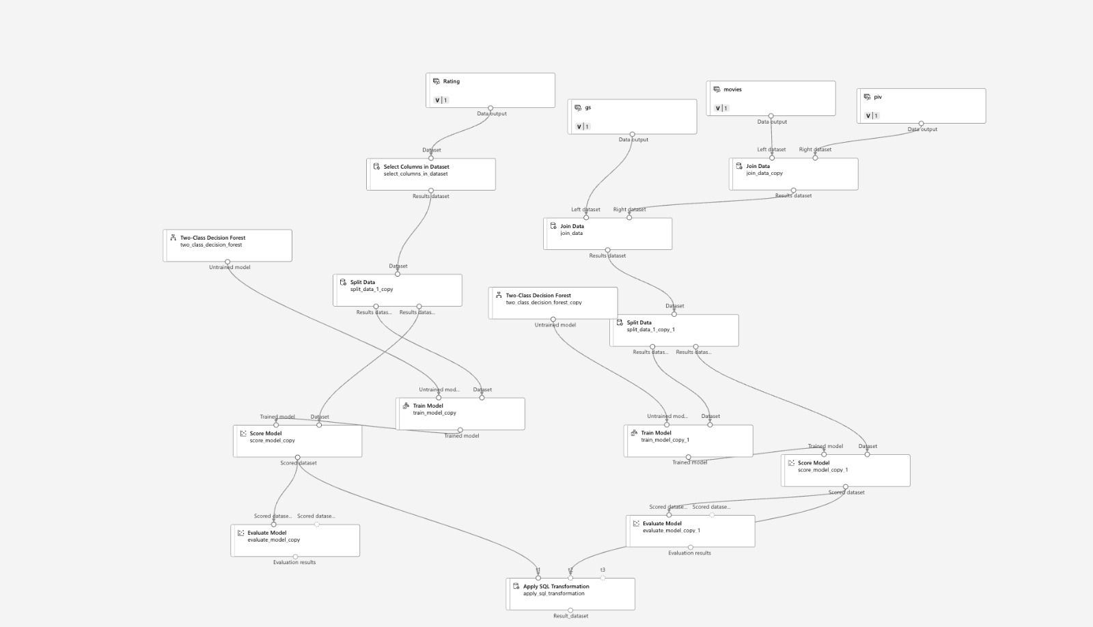
Random Forest

Slide 20
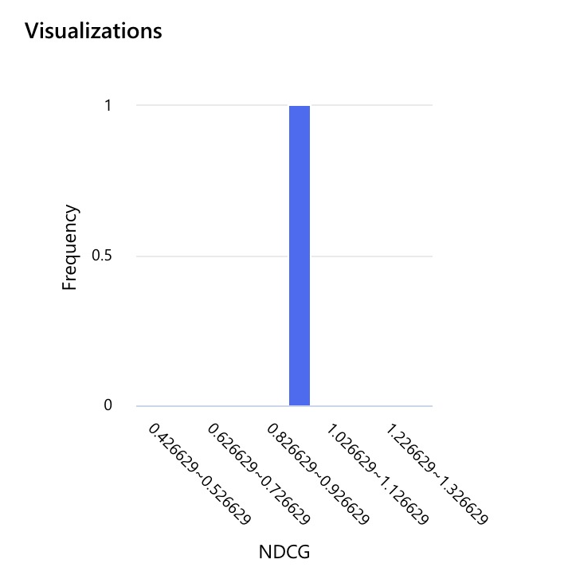
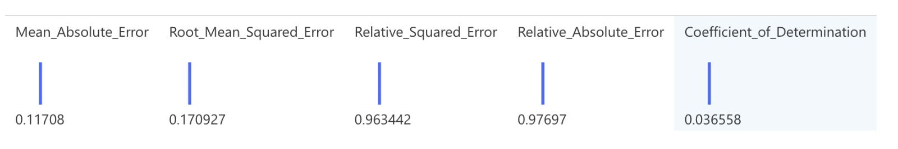
Integrated solution (recommendation flow)
SVD
(userId, MovieId, Features like Total Count, Average Rating, Relevance Score, Top 5 Preferred Genres)
(userId, movieId, Ratings)
(MovieID, Tags, Genome Scores)
TF-IDF
Random Forest
﻿{'Model': 'RandomForestRegressor', 'R² Score': 0.08158589350458367, 'RMSE': 0.793708011836573}
Predicted Ratings for top Movies

Slide 21
Challenges
This Movie Lens 25M dataset is very huge dataset.
Random forest also did not get to complete on cloud GPUs (Azure and colab pro)
Number of users = ﻿162541
Number of movies = 62423 - 3376
Only 14592 Users have tags data which is available for only 45251 unique movies.
Relevance Score is available for only 13816 movies.
No Domain Experts in this area to identify the Features for model training.
With huge dataset, hyper tuning of model for different parameter was time consuming.
Solution:
Accuracy drops due to insufficient data from tags and genome_scores.
Catalog the movies to recommend for users.
Pre process the Tags Data and retain only relevant tags instead of ~ 1000 unique tags.

Slide 22
Alternative Approaches
Deep Learning – Tried to implement the RNN and LSTM model but It takes massive time to train the model and it also requires the GPU
We also tried using ALS algorithm which works only with Pyspark. We had challenges in installing Pyspark in google colab.
We tried Xgboost classifier but training the model for even the limited data was also time consuming and was not running google colab.

Slide 23
Applications of the Movie Recommendation System
E-commerce
Cross/Upsell Products
Travel/Hospitality
Personalized/Curated Tours
Improved Customer Satisfaction
News/Article/Video Recommender
Exactly Similar Movie Recommender
Regular/Repeated Customer Engagement
Increased Customer Retention
Increased revenue is mostly through Ads
Curated Products/Discounts
Increase Customer Spends
Notes:
In Banking and financial industry, the system developed can be helpful to recommend the products and services by identifying the customer preferences and grouping customers together. To retain the customer, to increase the CSI and to increase the revenue for banks and financial services providers.
For News or Article or Video Recommendation. This works exactly as Movie Recommendation. To have viewer engaged regularly by emailing recommendation through email. Limited free articles will be available. Over and above read requires membership or payment.
In E-commerce: Recommend products to customers to increase the Customer spends, improve customer satisfaction and enhanced user segmentation
In Travel and Hospitality: Recommend Personalized Travel and Tour curated as per Customer's preferences and wishlist
For Hiring, recommendation systems can used by Companies to identify most suitable candidates by matching candidate's skillsets and preferences to companies' job requirements. Can be extended to Job website to match the candidates to job openings based on candidates' profiles and experience.
Recommendations can also be extended to Social Media and Matrimonial Websites
Offer curated services for HNI individuals. Amex offers complete travel and event management packages for HNI.

Slide 24
Applications Contd.
Social Media
Recommend friends and content
Job Portals
Match the Seeker’s skills to Employer’s needs.
Financial Services
Recommend Products/Services
Customer Engagement
Increase Revenue is through ads
Relevance Score
Urgency Scores
Urgency Scores
Relevance Scores
Customer Retention

Slide 25
References
https://jovian.com/enfadikop/movielens-fastai
https://github.com/dao-v/Movie_Recommendation_System/blob/master/Movie%20Recommendation%20System%20-%20GITHUB%20-%20V1.01.ipynb
https://labelyourdata.com/articles/movie-recommendation-with-machine-learning

Slide 26
Acknowledgement
We, the team members of Group 2 (2nd batch of Talentsprint) in PG Level Advanced Program in Applied Data Science and Machine Learning are very grateful to the mentor support throughtout the course.
For preparing the Capstone Project, we would like to thank Mohit, our Mentor for guiding us in each steps to complete the project and make it a success.

Slide 27
Team Members
Sl. No. | Name
1 | Deepika V
2 | Harmit Singh
3 | Priti Manickavachakam
4 | Mrityunjay Balkrishnan
5 | Sourav Sahu
6 | Mohd Arif Ansari
7 | Ipsita Roy Chowdhury
8 | Kritika Thadani
9 | Varun Sharma
10 | Bharath Vasudevan

Slide 28


Slide 29
Design Architecture – Random Forest
Uses all 5 csv files
GenerATE THE FEATURES
Using Random forest, we will use below features to predict the ratings of movieId derived from SVD and TfIdf Vectorizer.
﻿{'Model': 'RandomForestRegressor', 'R² Score': 0.08158589350458367, 'RMSE': 0.793708011836573}

